Slide 1

ANNAMACHARYA PG COLLEGE OF COMPUTER STUDIES
ONLINE E-LEARN AND EARN
UNDER THE GUIDANCE
  OF
  K. SUDHEER BABU
  Assistant Professor,
MCA Department.
Presented by
G.RATHNAKISHOR ROLLNO: 185N5F0021, MCA VI Semester, APGCCS.

Slide 2
CONTENTS
Data Design(Using ER-Model)
Data Dictionary
UML Design
  Use Case Diagram
  Class Diagram
  Sequence Diagram(s)
    Sequence Diagram for Select course
    Sequence Diagram for download material
    Sequence Diagram for set exam paper
    Sequence Diagram for conducting exam
  Activity Diagram(s)
    Sequence Diagram for select course
    Sequence Diagram for download material
    Sequence Diagram for set exam paper
    Sequence Diagram for conducting exam
  Deployment Diagram

Slide 3
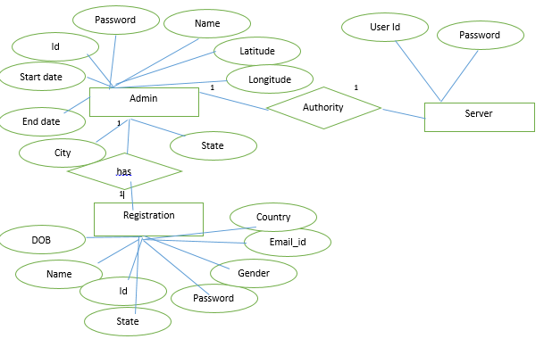
ER model

Slide 4
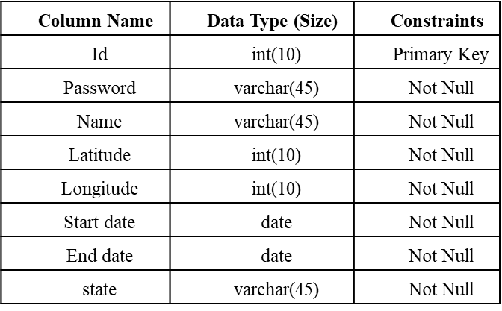
Data Dictionary
Table Name: Admin

Slide 5
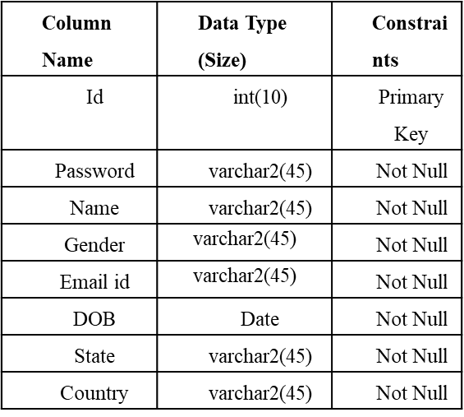
Table Name: Registration

Slide 6
Usecase diagram

Slide 7
class diagram

Slide 8
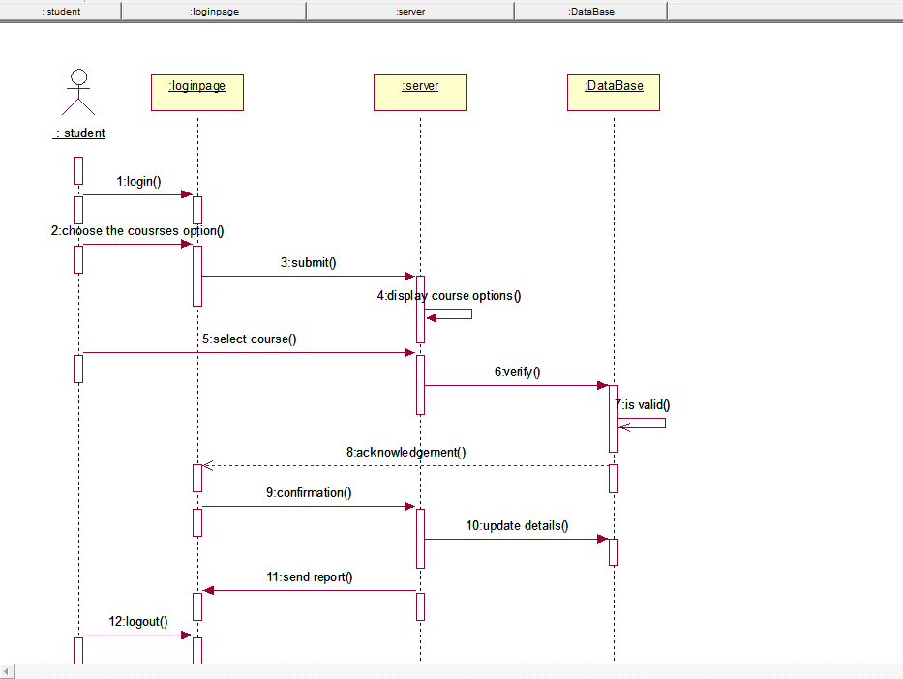
Sequence diagram for
Sequence diagram for select course

Slide 9
Sequence diagram for set exam paper

Slide 10
Sequence diagram for download material

Slide 11
Sequence diagram for conducting exam

Slide 12
Activity diagram for select course

Slide 13
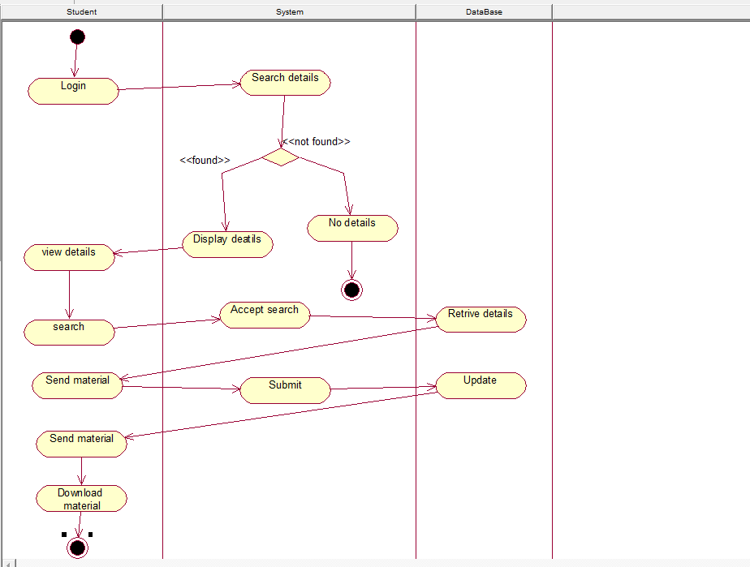
Activity diagram for download material

Slide 14
Sequence diagram for set exampaper

Slide 15
Activity diagram for conducting exam

Slide 16
Deployment diagram

Slide 17
Any Queries?

Slide 18
THANK YOU

